Slide 1
Function And Programs

Slide 2
2.1 Functions
From a high-level perspective, a program is a function. A program, like a function in mathematics, consumes inputs, and it produces outputs.
In contrast to mathematical functions, programs work with a whole variety of data: numbers, strings, images, and so on. Furthermore, programs may not consume all of the data at once; instead a program may incrementally request more data or not, depending on what the computation needs.

Slide 3
Kinds of definitions
constant definitions
E.g.: (define x 2)
function definitions
E.g.: (define (f a)
(* 10 a))

Slide 4
Exercise 13
Define a function that consumes two numbers, x and y, and that computes the distance of point (x,y) to the origin.

Slide 5
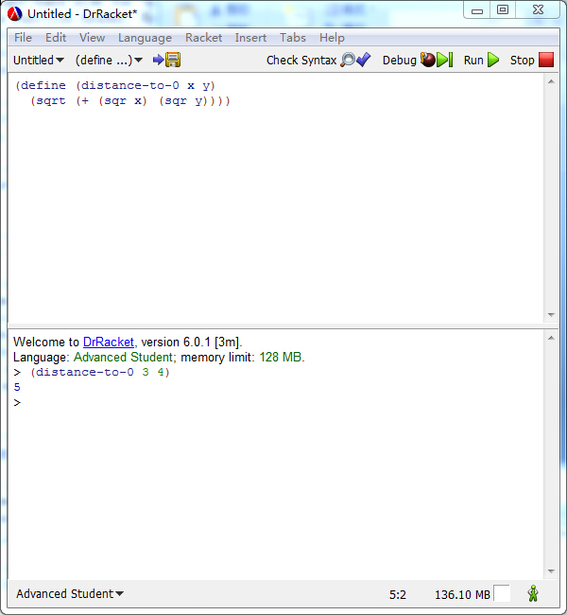

Slide 6
Exercise 14
Define the function cube-volume, which accepts the length of a side of a cube and computes its volume.

Slide 7
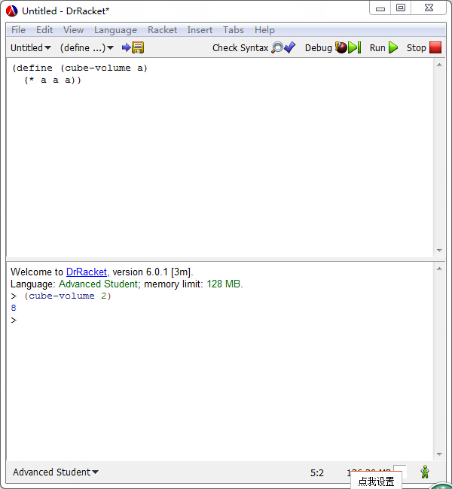

Slide 8
Exercise 15
Define the function string-first, which extracts the first character from a non-empty string. Don’t worry about empty strings.

Slide 9
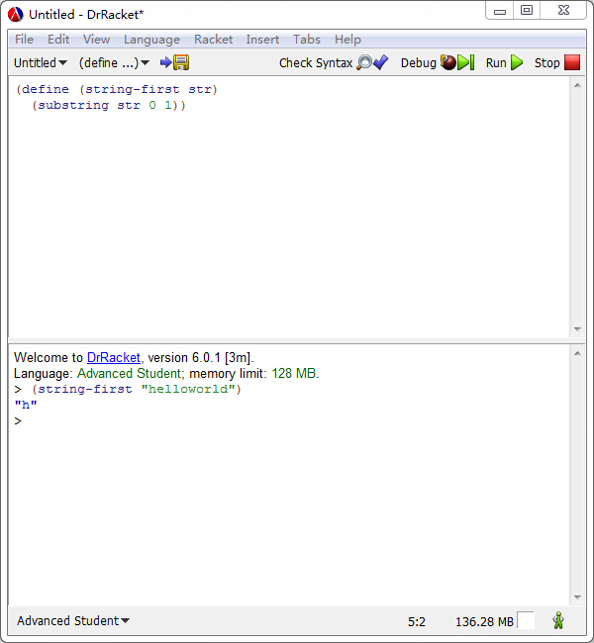

Slide 10
Exercise 16
Define the function string-last, which extracts the last character from a non-empty string. Don’t worry about empty strings.

Slide 11
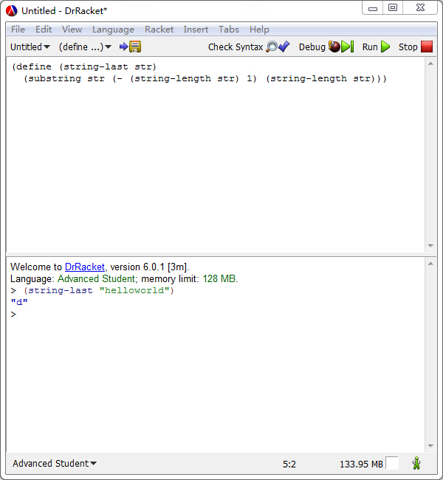

Slide 12
Exercise 17
Define the function bool-imply. It consumes two Boolean values, call them b1 and b2. The answer of the function is true if b1 is false or b2 is true. Note: Logicians call this Boolean operation implication and often use the symbol =>, pronounced “implies,” for this purpose.

Slide 13
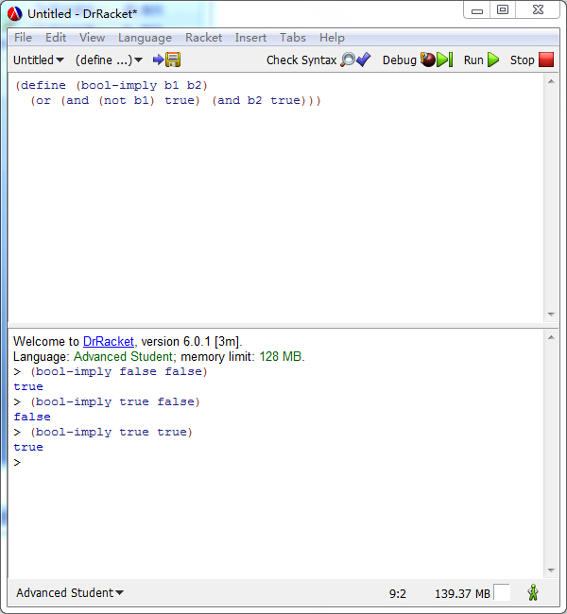

Slide 14
Exercise 18
Define the function image-area, which counts the number of pixels in a given image.

Slide 15
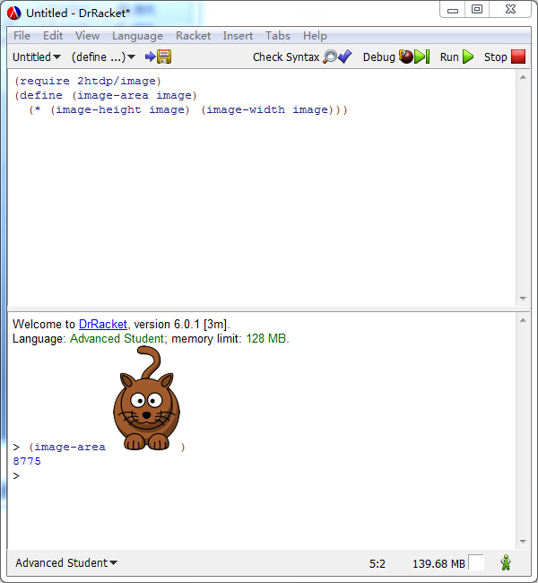

Slide 16
Exercise 19
Define the function image-classify, which consumes an image and produces "tall" if the image is taller than it is wide, "wide" if it is wider than it is tall, or "square" if its width and height are the same.

Slide 17
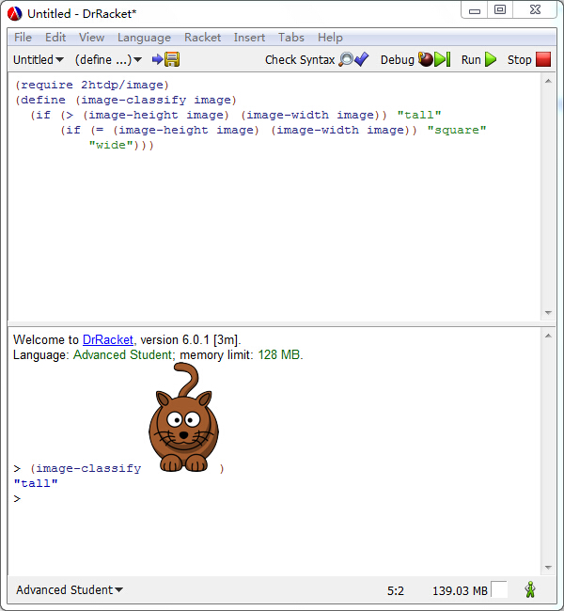

Slide 18
Exercise 20
Define the function string-join, which consumes two strings and appends them with "_" in between.

Slide 19
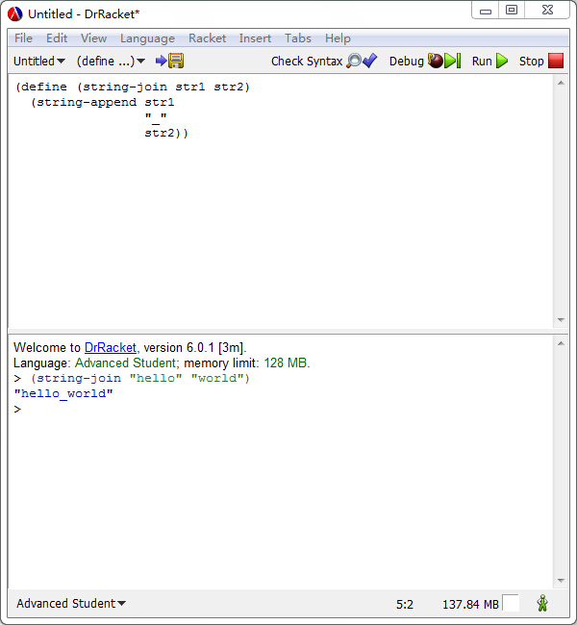

Slide 20
Exercise 21
Define the function string-insert, which consumes a string and a number i and which inserts "_" at the ith position of the string. Assume i is a number between 0 and the length of the given string (inclusive).

Slide 21
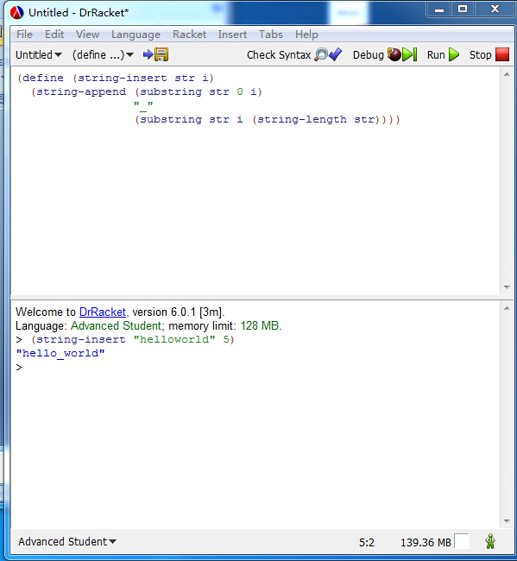

Slide 22
Exercise 22
Define the function string-delete, which consumes a string and a number i and which deletes the ith position from str. Assume i is a number between 0 (inclusive) and the length of the given string (exclusive).

Slide 23
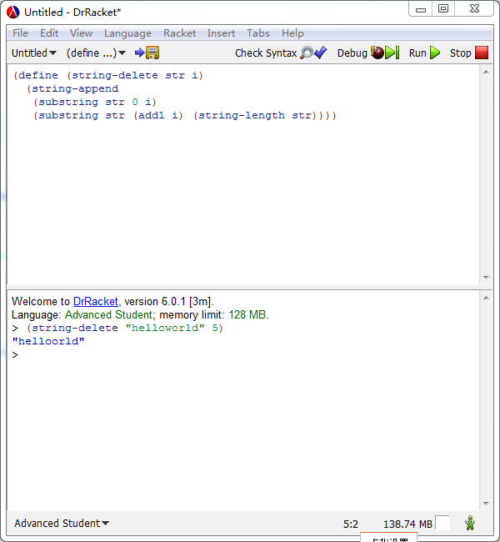

Slide 24
2.2 Composing Functions
A program rarely consists of a single function definition and an application of that function. Instead, a typical program consists of a “main” function or a small collection of “main event handlers.” All of these use other functions—built-in primitives as well as functions that you define—and turn the result of one function application into the input for another.

Slide 25
Sample problem
Imagine the owner of a monopolistic movie theater. He has complete freedom in setting ticket prices. The more he charges, the fewer the people who can afford tickets. The less he charges, the more it costs to run a show because attendance goes up. In a recent experiment the owner determined a relationship between the price of a ticket and average attendance.
At a price of $5.00 per ticket, 120 people attend a performance. For each 10-cent change in the ticket price, the average attendance changes by 15 people. That is, if the owner charges $5.10, some 105 people attend on the average; if the prices goes down to $4.90, average attendance increases to 135.

Slide 26
Sample problem
Unfortunately, the increased attendance also comes at an increased cost. Every performance comes at a fixed costs of $180 to the owner plus a variable cost of $0.04 per attendee.
The owner would like to know the exact relationship between profit and ticket price so that he can determine the price at which he can make the highest profit.

Slide 27
Solution
The best choice is to tease out the various dependencies, one by one:
Define the attendees first
(define (attendees ticket-price)
(- 120 (* (- ticket-price 5.0) (/15 0.1))))
Then, define the revenue
(define (revenue ticket price)
(* ticket-price (attendees ticket-price)))

Slide 28
Solution
Thirdly, define the cost
(define (cost ticket-price)
(+ 180 (* 0.04 (attendees ticket-price))))
Finally, define profit
(define (profit ticket-price)
(- (revenue ticket-price)
(cost ticket-price)))

Slide 29
2.4 Programs
From a coding perspective, a program is just a bunch of function and constant definitions. Usually one function is singled out as the “main” function, and this main function tends to compose others.

Slide 30
2.4 Programs
From the perspective of launching a program, however, there are two distinct kinds.

Slide 31
2.4 Programs
a batch program consumes all of its inputs at once and computes its result. Its main function composes auxiliary functions, which may refer to additional auxiliary functions, and so on. When we launch a batch program, the operating system calls the main function on its inputs and waits for the program’s output.

Slide 32
2.4 Programs
an interactive program consumes some of its inputs, computes, produces some output, consumes more input, and so on. We call the appearance of an input an event, and we create interactive programs as event-driven programs. The main function of such an event-driven program uses an expression to describe which functions to call for which kinds of events. When we launch an interactive program, the main function informs the operating system of this description. As soon as input events happen, the operating system calls the matching functions. Similarly, the operating system knows from the description when and how to present the results of these function calls as output.

